Slide 1
Health Protection Surveillance Centre
Sexually Transmitted Infections (STIs) in Ireland:
Trends to the end of 2018
September 2019

Slide 2
Acknowledgements
The Health Protection Surveillance Centre (HPSC) would like to thank all those who provided the data for this report, particularly the STI clinics, GPs, laboratories and personnel within the Departments of Public Health.
STI data were extracted from CIDR between July and September, 2019, and may differ from those previously published due to ongoing updating of notification data in CIDR.
These slides may be copied and reproduced, provided HPSC is acknowledged. Suggested citation: HSE-Health Protection Surveillance Centre. STI slideset 2018. Dublin: HPSC; 2019.

Slide 3
STIs in Ireland, 2018
These slides present data on STIs notified to HPSC during 2018 and trends to the end of 2018.
More detailed reports on the epidemiology of STIs for 2018 are available on the HPSC website.
HIV, hepatitis B and sexually transmitted enteric infections (STEI), such as shigellosis, are notified via CIDR and are reported separately.
https://www.hpsc.ie/a-z/sexuallytransmittedinfections/
https://www.hpsc.ie/a-z/sexuallytransmittedinfections/publications/stireports/
https://www.hpsc.ie/abouthpsc/annualreports/

Slide 4
Summary of STIs in Ireland, 2018
Increasing trend in STIs continues in 2018
STI* | Number | Notification rate / 100,000 population | Highest age-specific rate | Percentage change in rate from 2017
Anogenital warts | 1,031 | 21.7 | 25-29 years | ***
Chlamydia | 7,932 | 166.6 | 20-24 years | +7%
Gonorrhoea | 2,405 | 50.5 | 25-29 years | +7%
Herpes simplex (genital) | 1,591 | 33.4 | 20-24 years | +2%
Lymphogranuloma venereum (LGV) | 28 | 0.6 | 30-34 years | +50%
Non-specific urethritis (NSU) | 518 | 10.9 | ** | ***
Early infectious syphilis (EIS) | 484 | 10.2 | 25-29 years | +22%
Trichomoniasis | 64 | 1.3 | 25-29 years | -7%
Total | 14,053
* There were no notifications of chancroid or granuloma inguinale in 2018
** Data provided as total numbers only, breakdown by age not available
*** Interpretation of AGW and NSU trends is difficult due to under-reporting in 2018

Slide 5
Key population groups
Young people
  Notifications of chlamydia, herpes simplex and gonorrhoea in 15-24 year olds remained high in 2018; further information on STIs in young people is available at http://www.hpsc.ie/a-z/hivstis/sexuallytransmittedinfections/publications/stireports/
  In 2018, 15-24 year olds accounted for:
    49% of chlamydia cases
    39% of herpes simplex cases
    32% of gonorrhoea cases
MSM (men who have sex with men)
  Notifications of early infectious syphilis and gonorrhoea in MSM increased in 2018; further information is available in annual epidemiological reports at http://www.hpsc.ie/abouthpsc/annualreports/
  In 2018, MSM accounted for:
    100% of LGV cases
    86% of early infectious syphilis cases
    65% of gonorrhoea cases
    (where mode of transmission was known)

Slide 6
Preventing STIs
Safer sex and STI testing
Use condoms for vaginal, oral and anal sex
Reduce the number of partners and overlapping partners
Get tested for STIs if:
  You have symptoms of an STI;
  Change your sexual partner;
  Have multiple or overlapping partners;
  Your partner has an STI.
Further information on STIs and free sexual health services is available at
  https://www.sexualwellbeing.ie/
  www.man2man.ie (resource for gay and bisexual men and other men who have sex with men in Ireland)

Slide 7
Anogenital warts in Ireland, 2018
Summary
1,031 cases of ano-genital warts notified in 2018, down from 1,281 cases in 2017
Notification rate was 21.7 per 100,000 population
57% of cases were male
The highest age-specific rate was among 25-29 year olds, for both males and females, at 119.8/100,000 and 69.0/100,000, respectively
Trends in the number and rate of AGW notifications should be interpreted with caution due to underreporting of cases in one HSE area for the second half of 2018, and due to missing data from some STI services in two HSE areas since 2013.

Slide 8
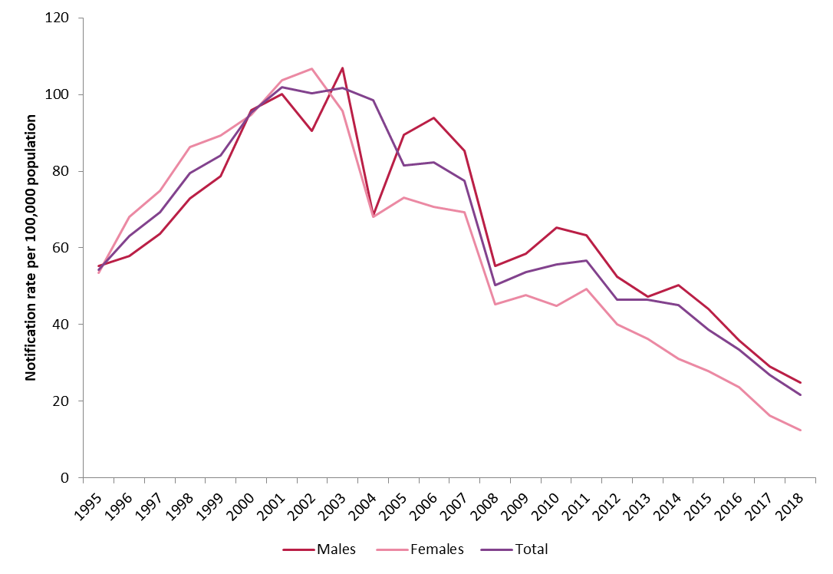
Anogenital warts in Ireland
Figure 1. Trend in notification rate of anogenital warts by sex, 1995-2018

Slide 9
Chlamydia in Ireland, 2018
Summary
7,932 cases of chlamydia notified in 2018 (166.6 per 100,000 population)
  7% increase on 2017
Increase was higher in males (+11%) than females (+4%)
  Females: increase highest in younger age groups (15-24 years)
  Males: increase highest in older age groups (≥25 years)
Rate in males exceeded rate in females for the first time
49% of cases were young people aged 15-24 years

Slide 10
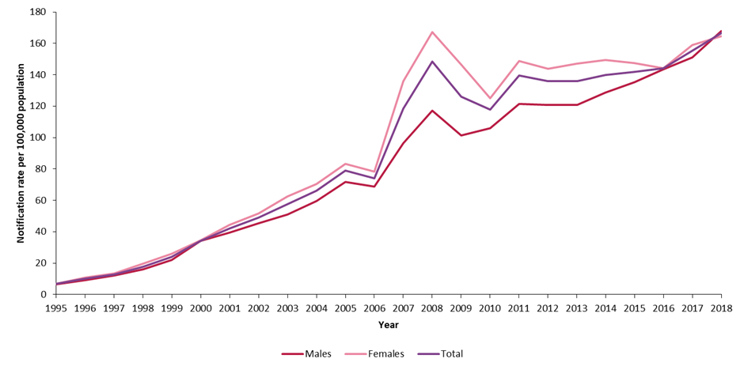
Chlamydia in Ireland
Figure 2. Trend in notification rate of chlamydia by sex, 1995-2018

Slide 11
LGV in Ireland, 2018
Summary
28 cases of Lymphogranuloma venereum (LGV) notified in 2018, up from 20 cases in 2017
Notification rate was 0.6 per 100,000 population
Median age: 36 years (range: 22-58 years)
All cases were men who have sex with men
29% did not have symptoms of LGV infection
64% were HIV positive

Slide 12
Gonorrhoea in Ireland, 2018
Summary
2,405 cases of gonorrhoea notified in 2018
Notification rate increased by 7% to 50.5/100,000 from rate in 2017
  Rate increased by 86% since 2015
84% males, 16% females
Median age: 28 years (range: 16-72 years)
Highest rate among males: 25-29 year age group (362.2/100,000);
Highest rate among females: 20‑24 year age group (120.5/100,000)
Almost a third (32%) of cases were young people aged 15-24 years
65% of cases were among MSM and 35% among heterosexuals, where mode of transmission was known
  Rate among MSM has doubled since 2015

Slide 13
Gonorrhoea in Ireland
Figure 3. Trend in notification rate of gonorrhoea by sex, 1995-2018
Introduction of case-based reporting

Slide 14
Herpes simplex (genital) in Ireland, 2018
Summary
1,591 cases of herpes simplex (genital) notified in 2018
Notification rate was 33.4 per 100,000 population in 2018; a 2% increase since 2017 (32.6/100,000)
72% of cases were among females
The highest age-specific rate was among females aged 20-24 years (266.8/100,000)
Median age: 27 years (range:14-84 years)
63% of cases were laboratory confirmed as herpes simplex virus type 1 and 36% as herpes simplex virus type 2; virus type was unknown for 1% of cases

Slide 15
Herpes simplex (genital) in Ireland
Figure 4. Trend in notification rate of herpes simplex (genital) by sex, 1995-2018

Slide 16
Early infectious syphilis in Ireland, 2018
Summary
484 confirmed cases of early infectious syphilis (EIS) were notified in 2018
Notification rate increased to 10.2 per 100,000 population; up 22% from 2017 (8.4/100,000)
96% of cases were among males
Median age: 34 years (range:16-76 years)
The highest rate in males was in 30-34 year olds (57.2 per 100,000 population) and in females was in 20-24 year olds (6.6 per 100,000 population)
The majority (78%) of cases were reported by HSE East
Where mode of transmission was recorded, 86% of cases were in MSM
Where HIV status was recorded, 40% of EIS cases were co-infected with HIV
25% of cases were consistent with syphilis reinfection

Slide 17
Early infectious syphilis in Ireland
Figure 5. Trend in notification rate of early infectious syphilis by sex, 2000-2018
Case definition updated
Case definition and procedure for notification updated

Slide 18
Trichomoniasis in Ireland, 2018
Summary
64 cases of trichomoniasis notified in 2018
The notification rate was 1.3 per 100,000 population, and has remained fairly steady since the early 2000s
Sixty three cases (98%) were female, one male case was reported (2%)
Median age: 34 years (range: 20-62 years)
Numbers and rates should be interpreted with caution as some laboratories use new molecular testing methods that are not currently included in the laboratory criteria for notification, therefore cases may be underreported.

Slide 19
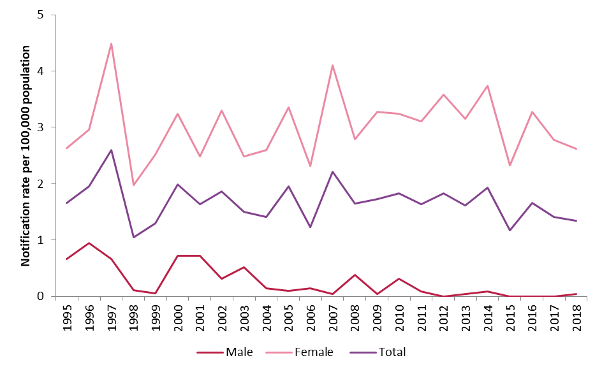
Trichomoniasis in Ireland
Figure 6. Trend in notification rate of trichomoniasis, by sex 1995-2018

Slide 20
Other notifiable STIs in Ireland, 2018
Summary: chancroid, granuloma inguinale and non-specific urethritis
There were 518 cases of non-specific urethritis (NSU) notified in 2018, a notification rate of 10.9 per 100,000 population. Interpretation of NSU trends is difficult due to increased underreporting of cases in the second half of 2018, and given the absence of information on the causes of NSU.
There were no notifications of chancroid or granuloma inguinale reported in Ireland in 2018

Slide 21
Further Information
More detailed tables on these provisional data are available on the HPSC website
More detailed epidemiological reports are also available on the HPSC website
You can stay up-to-date with current STI data with the Weekly HIV & STI report
https://www.hpsc.ie/a-z/sexuallytransmittedinfections/publications/stireports/
http://www.hpsc.ie/abouthpsc/annualreports/
https://www.hpsc.ie/a-z/sexuallytransmittedinfections/publications/stireports/stiweeklyreports/

